Slide 1

Grocery Store Management

Slide 2




Grocery Store Management

Slide 3

Objectives
To establish and implement a relational database designed for grocery store activities.
To effectively manage and maintain inventory, suppliers, customers, employees, and orders.
To allow for data retrieval and manipulation using SQL queries.
To carry out business analysis such as sales trends, customer insights, supplier performance, and employee effectiveness.
To engage in joins, subqueries, and aggregations for solving real-world problems in SQL.
To generate actionable insights that contribute to improved operational efficiency and decision-making.

Slide 4
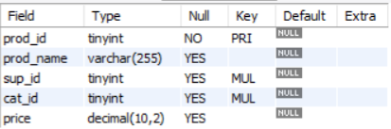



TABLES
Product Table
Suppliers Table
Categories Table
Customers Table

Slide 5
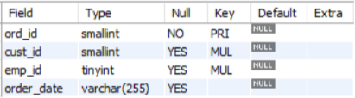
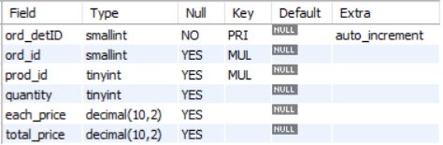

TABLES
Orders Table
Order Details Table
Employees Table

Slide 6
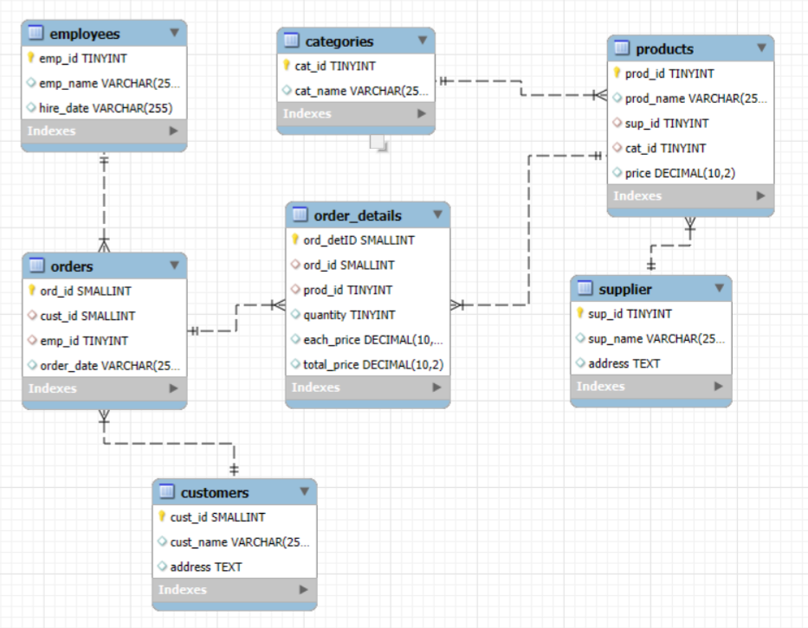
ER Diagram

Slide 7
Problem Statement
Grocery stores commonly deal with difficulties in efficiently tracking inventory, suppliers, and sales data.
The lack of a centralized database system hinders the management of products, customers, and employees.
Businesses face challenges in analyzing customer behavior and recognizing top customers or purchasing trends.
Without effective data management, monitoring best-selling products and revenue patterns proves to be challenging.
Poor data handling leads to obstacles in supplier contribution analysis and tracking employee performance.
Extracting trends related to time-based sales or orders becomes intricate when data is not organized in structured formats.

Slide 8


How many unique customers have placed orders?

Slide 9
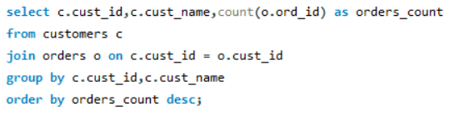
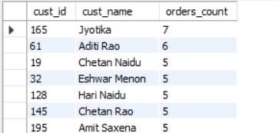
Which customers have placed the highest number of orders?

Slide 10
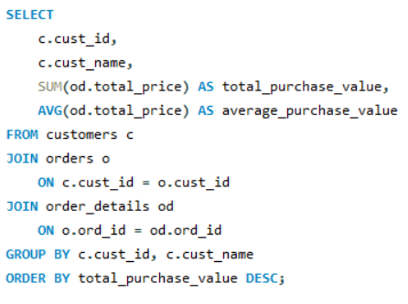
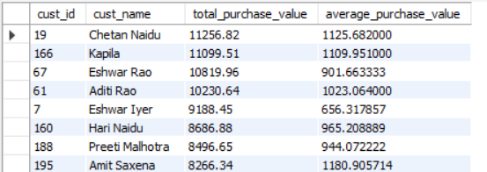
What is the total and average purchase value per customer?

Slide 11
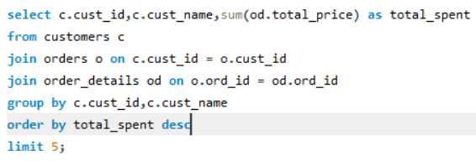
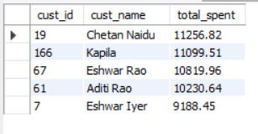
Who are the top 5 customers by total purchase amount?

Slide 12
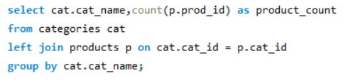
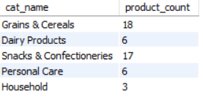
How many products exist in each category?

Slide 13
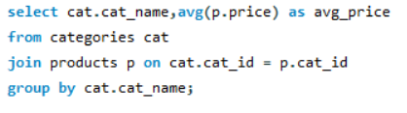
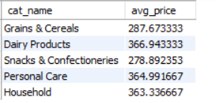
What is the average price of products by category?

Slide 14
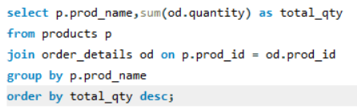
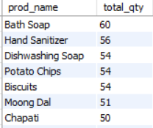
Which products have the highest total sales volume (by quantity)?

Slide 15
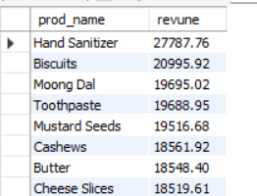
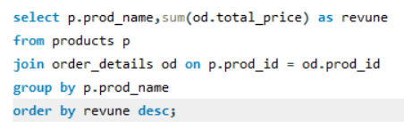
What is the total revenue generated by each product?

Slide 16
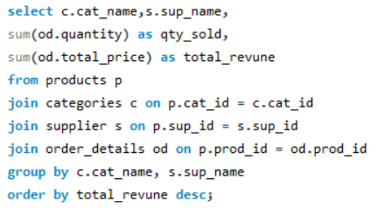
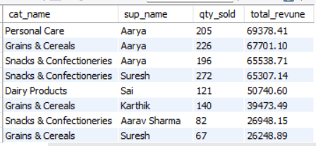
How do product sales vary by category and supplier?

Slide 17


How many orders have been placed in total?

Slide 18


What is the average value per order?

Slide 19
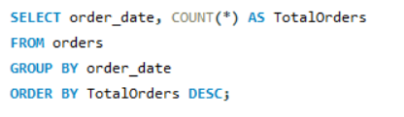
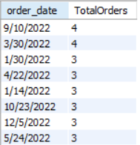
On which dates were the most orders placed?

Slide 20
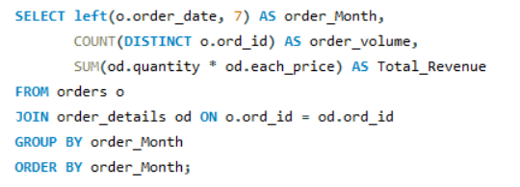
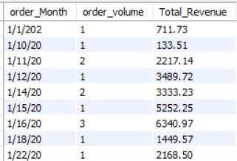
What are the monthly trends in order volume and revenue?

Slide 21
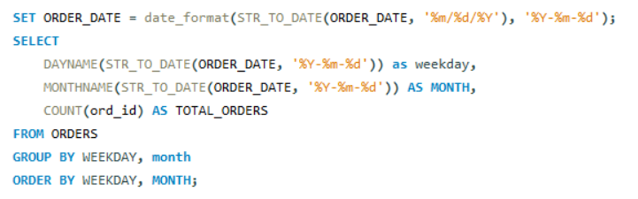
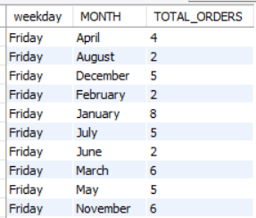
How do order patterns vary across weekdays and weekends?

Slide 22


How many suppliers are there in the database?

Slide 23
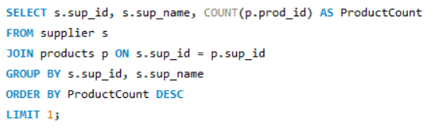

Which supplier provides the most products?

Slide 24
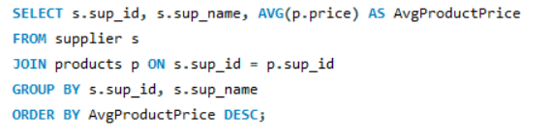
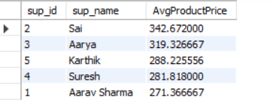
What is the average price of products from each supplier?

Slide 25
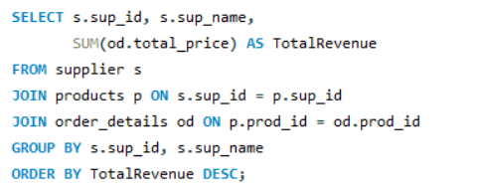

Which suppliers contribute the most to total product sales (by revenue)?

Slide 26


How many employees have processed orders?

Slide 27
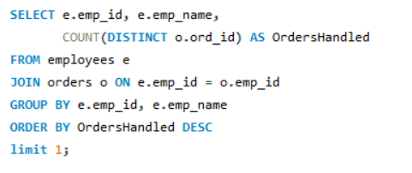

Which employees have handled the most orders?

Slide 28
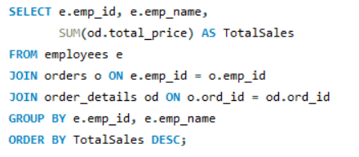
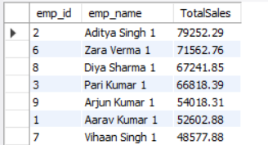
What is the total sales value processed by each employee?

Slide 29
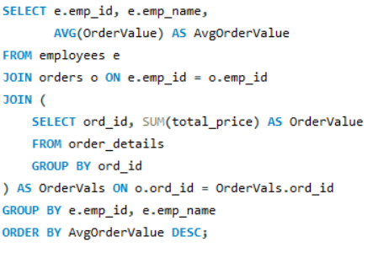
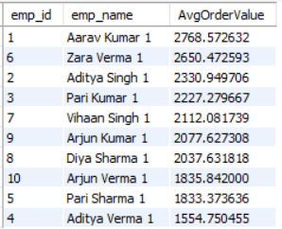
What is the average order value handled per employee?

Slide 30
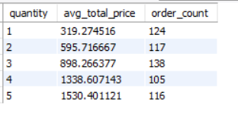
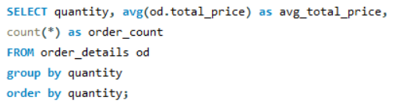
What is the relationship between quantity ordered and total price?

Slide 31
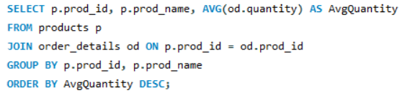
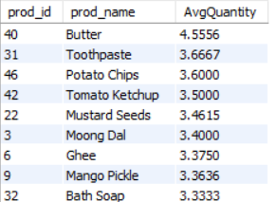
What is the average quantity ordered per product?

Slide 32
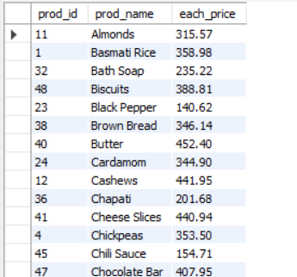
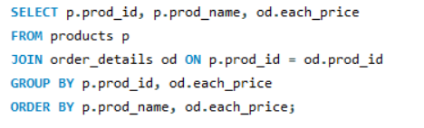
How does the unit price vary across products and orders?

Slide 33
Insights
Customer data indicates that frequent purchasers are the primary contributors to revenue, underscoring the significance of customer loyalty.
The top five clients account for a substantial portion of overall sales. Specific product categories, such as beverages and snacks, consistently exhibit higher sales volumes.
Revenue trends fluctuate throughout the months, with peak ordering periods reflecting seasonal purchasing habits.
A limited number of suppliers deliver the majority of products, making the evaluation of supplier performance essential.
The handling of orders by employees varies, with some individuals processing a considerably higher number of orders than their peers.
Order trends reveal distinct differences between weekdays and weekends, which can inform staffing strategies.

Slide 34
Conclusion
The project effectively showcased the capability of a relational database to manage grocery store operations with high efficiency.
By utilizing SQL, we successfully extracted significant business insights regarding customers, products, suppliers, sales, and employees.
The analysis brought to light essential factors including leading customers, top-selling products, seasonal patterns, and supplier contributions.
This database-oriented strategy aids in enhancing decision-making, optimizing inventory levels, and increasing overall operational efficiency.
The project establishes a robust basis for practical applications of data management and analytics within the retail sector.

Slide 35

THANK YOU

